Slide 1
More AI and Machine Learning
CITS5503 Dr David Glance

Slide 2
Amazon Comprehend
Analyze any text and provides information on:
Entities – people, places, locations
Key phrases – pertinent to the subject of the document
Language - detect the language of the text
Sentiment – sentiment analysis of the text
Topic Modelling - Analyze a corpus of documents and find common themes

Slide 3
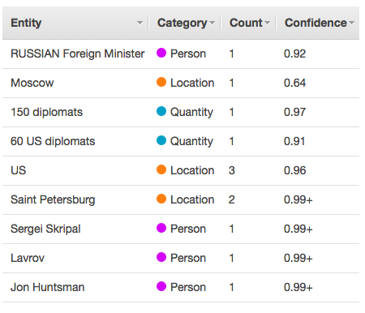
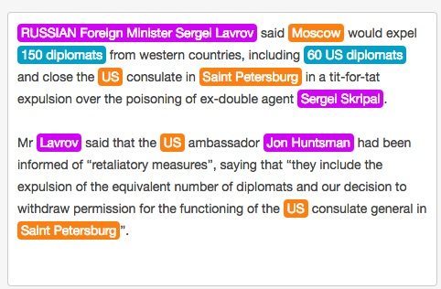
API Explorer

Slide 4
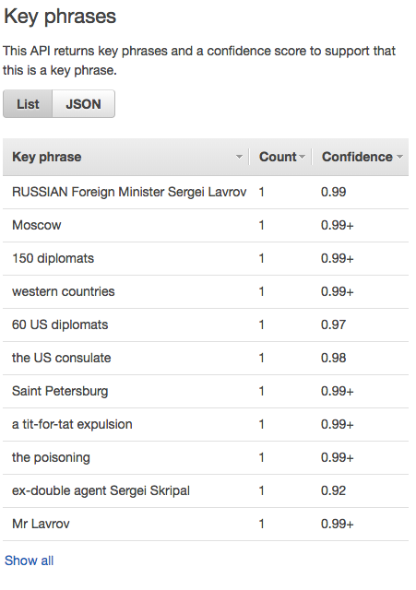
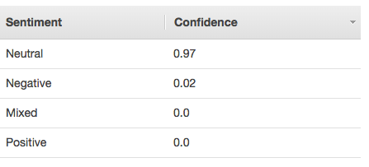
Key phrases and sentiment

Slide 5
In code
import boto3
import json
comprehend = boto3.client(service_name='comprehend', region_name='us-east-1')
text = "I am so very happy that it is raining today in Seattle"
print('Calling DetectSentiment')
print(json.dumps(comprehend.detect_sentiment(Text=text, LanguageCode='en'), sort_keys=True, indent=4))
print('End of DetectSentiment\n')

Slide 6
Amazon Rekognition
Image and Video recognition services
Searchable images and video libraries
Face-based user verfication
Sentiment and demographic analysis – happy, sad, gender
Facial recognition
Unsafe content detection
Celebrity recognition
Text detection

Slide 7
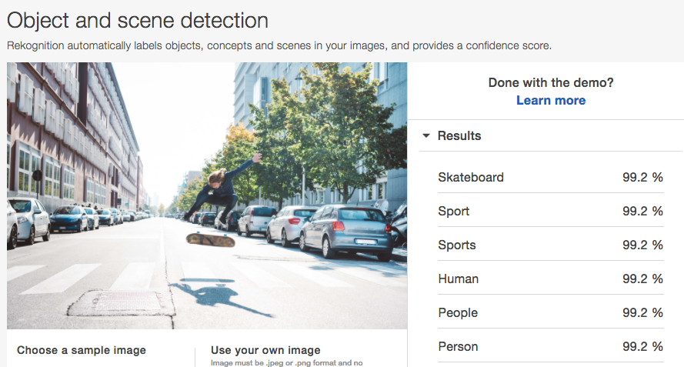
Object and scene detection

Slide 8
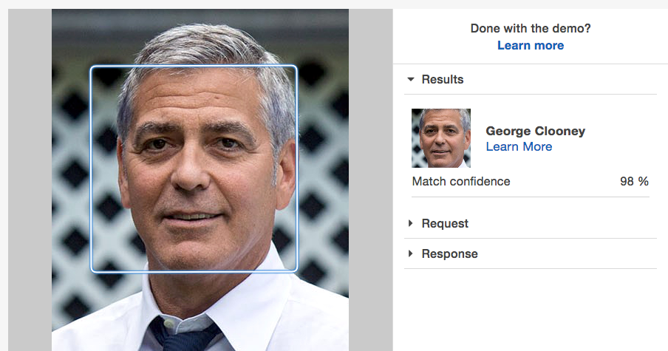
Celebrity Recognition

Slide 9
Amazon Lex
Based on the same technology as Alexa
Built on Natural Language Understanding (NLU) and Automatic Speech Recognition (ASR)
Also needs to action commands
Similar technology to HomePod (Siri) and Google Home (Google Assistant)
Can use it to create Chatbots

Slide 10
Chatbots
Conversational software with varying levels of artificial intelligence
ELIZA MIT Joseph Weizenbaum 1966 – imitated a psychotherapist
PARRY Kenneth Colby 1972 - imitated a patient with schizophrenia
Jabberwacky Rollo Carpenter 1988
ALICE (Artificial Linguistic Internet Computer Entity)
Siri, Google Now, Cortana, Alexa, etc

Slide 11
Chatbot approaches
Retrieval based (also rules based)
Use a heuristic to access predefined responses
Heuristic can be simple pattern matching or machine learning classification
Generative model
Generate new responses from scratch
Long vs short conversations
short is obviously easier
Open domain vs closed domain
restricting topic is easier

Slide 12
Common problems
Babbling
Coherent personality
Incorporating context
linguistic and physical
Evaluating models
Hard to do automatically
Intention and diversity
Humans produce diverse responses with intention – hard with generative systems (Google’s early version of chat bot tended to respond with “I love you”

Slide 13
Rule-based bots
No AI
Specific tasks handled
Recognises triggers
Job of scripts are to:
Clean and normalise text
Correct spelling
Convert idioms
Remove junk words
Expand abbreviations
Identify triggers
Scripting environments: SuperScript, botpress using Universal Message Markdown, etc

Slide 14
AI-based bots
Can learn through conversations
So can be trained
Problem if this is done unsupervised as in Microsoft’s Tay Twitter bot that went horribly wrong
AIML 2.0 scripting language mostly rule-based but can learn categorical information
Possible to create deep neural network based chat bots that learn conversations from databases of conversations

Slide 15
Turing test
Alan Turing 1950: test a machine’s ability to exhibit intelligent behaviour indistinguishable from a human’s
Turing test involves a tester sending questions to a human female and male and the tester asked to distinguish which person was which. A computer replaces one of the subjects and the test is repeated. Aim is for the guesses of male/female should be the same in the computer case.
Chatbots have been getting better at finessing the competitions like the Loebner prize – but basically still “cheating” https://theconversation.com/a-computer-beating-humans-and-passing-turings-test-wasnt-a-fair-fight-27367

Slide 16
Back to Lex
Create a bot using a Blueprint:
Intent – what the bot is programmed to do on the receipt of an utterance – example intents are:
OrderFlowers, BookTrip, ScheduleAppointment
Slot types
Roses, Lilies, Tulips
Slots
PickupTime, FlowerType, PickupDate
Utterances
”I would like to order some flowers”
Prompts
spoken prompts for the slots “What type of flowers would you like to order?”

Slide 17
New skills and deployment
Alexa can be trained with new skills, intents etc
Deployment to:
Facebook
Kik
Slack
Mobile applications

Slide 18
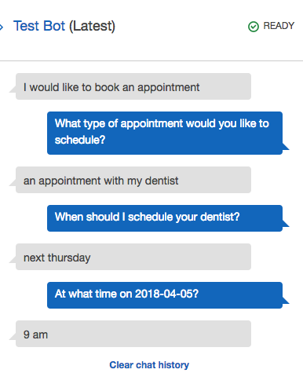
Example Bot
ScheduleAppointment
Intents:
MakeAppointment
Slot types
Appointment Type
Appointment Date
Appointment Time
Utterances
Book a {AppointmentType}
I would like to book an appointment

Slide 19
Alternatively…
MILABOT
Serban et al (2017) A deep reinforcement learning chatbot (https://arxiv.org/pdf/1709.02349.pdf)
Uses an ensemble approach including:
Rules-based: Alicebot, Elizabot, Initiatorbot, Storybot, Evibot, BoWMovies
Retrieval-based neural networks:
VHRED models (VHREDRedditNews, VHREDSubtitles, etc)
SkipThought Vector Models
Search engine-based neural networks
Generation-based neural networks

Slide 20
Amazon SageMaker
Environment for carrying out machine learning tasks
Based on Jupyter notebook software that mixes text, visualisations and the ability to execute live code
SageMaker will create environments – machines and containers to run the code specified in Jupyter
SageMaker consists of a Jupyter server and various frameworks and support for built-in algorithms
Linear, XGBoost, K-Means, Sequence to Sequence, DeepAR Forecasting, etc

Slide 21
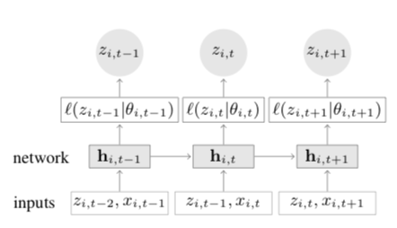
DeepAR Temperature Time Series
DeepAR uses Long short-term memory (LSTM)-based Recurrent Neural Network (RNN)
more info: https://arxiv.org/pdf/1704.04110.pdf

Slide 22
RNN and LSTMs
A
RNN has units that process sequential information in a sequential way with memory
[A] Repeating module in a standard RNN – single layer
[B] Repeating module in LSTM – 4 layers
B

Slide 23
Using DeepAR to predict temperature
Dataset global average temperature
Results are based on
41,811 monthly time series with 16,130,972 observations and
41,918 daily time series with 409,084,189 observations
Consists of
Date Number Year Month Day Day of Year Anomaly
1880.001 1880 1 1 1 -0.808
1880.004 1880 1 2 2 -0.670
Temperatures are reported as delta of 1951-1980 average (8.68°C).

Slide 24
Processing
Read in data and put into arrays
Plot of data
Create json files for training and upload to S3
Create a session to train data
estimator = sagemaker.estimator.Estimator(
sagemaker_session=sagemaker_session,
image_name=image_name,
role=role,
train_instance_count=1,
train_instance_type='ml.c4.8xlarge',
base_job_name='daily-temperature',
output_path=output_path
)

Slide 25
Training parameters
hyperparameters = {
"time_freq": 'D', # daily series
"context_length": prediction_length,
"prediction_length": prediction_length, # number of data points to predict
"num_cells": "40",
"num_layers": "2",
"likelihood": "gaussian",
"epochs": "250",
"mini_batch_size": "32",
"learning_rate": "0.00001",
"dropout_rate": "0.05",
"early_stopping_patience": "10" # stop if loss hasn't improved in 10 epochs
}

Slide 26
Deploy and use for prediction
Once the training is complete
Pick an instance to deploy model to
Create a request for prediction
Test using test data 1984 and 2018

